Slide 1
Dunovskyi Artem Serhiyovich
Patient presentation

Slide 2
Male, 48 y.o. ADL 1
Chief complaint:
Constant spastic pain in the coccyx and perineum, which sometimes worsens with acute cutting pain. The pain worsens when fecal masses enlarge the intestine.
Fecal and urinary incontinence.
Absence of sensitivity of the glutes, genitals, and left lower leg;
Limited mobility: walks with a limp (without using assistive devices), and cannot sit for a long time due to pain in the tailbone, and leg cramps.

Slide 3
Clinical diagnosis
Consequences of a mine explosive injury (December 24, 2022 - gunshot fracture of the sacrum) in the form of post-traumatic lumbosacral plexopathy. Condition after surgery (15.02.2023 laminectomy at the level of S2-33, decompression of spinal roots), bilateral S2-S3 radiculopathy - more on the left, pain syndrome, sensitive disorders, pelvic organ function disorders of the peripheral type. Post thrombophlebitis syndrome, chronic venous insufficiency stage 2A of the left lower limb (state after ligation of the saphenous vein on December 24, 2023). Partial impairment of spinal function. Partial dysfunction of the lumbosacral nerve plexus. Partial impairment of the functions of the left lower extremity. Partial impairment of the movement function. Partial violation of support function and gait. Violation of tolerance to physical exertion.

Slide 4
24.12.2022 received a combined injury:
A gunshot fragment blind wound of soft tissues of the left posterior cervical and occipital areas;
A gunshot fragment penetrating wound of the left pleural cavity with a left side pneumothorax;
A gunshot wound caused by a ricocheting bullet, resulting in a through-and-through combined penetrating injury to the abdominal cavity and spinal canal at the S2-S3 level, with an entry wound in the right iliac region, a gunshot comminuted fracture of the sacral bone, a gunshot comminuted fracture of the left iliac bone with injury to the left iliac vein, and an exit wound in the left gluteal region.

Slide 5
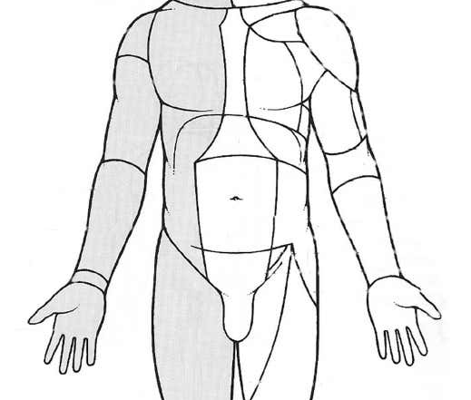
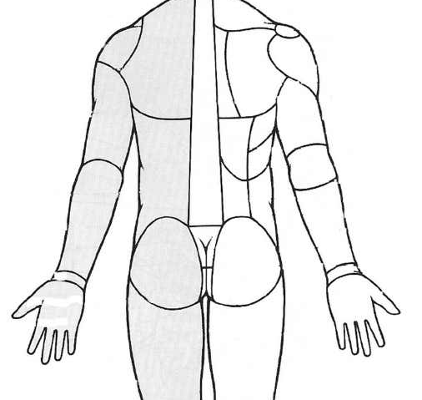
entry wound
exit wound

Slide 6
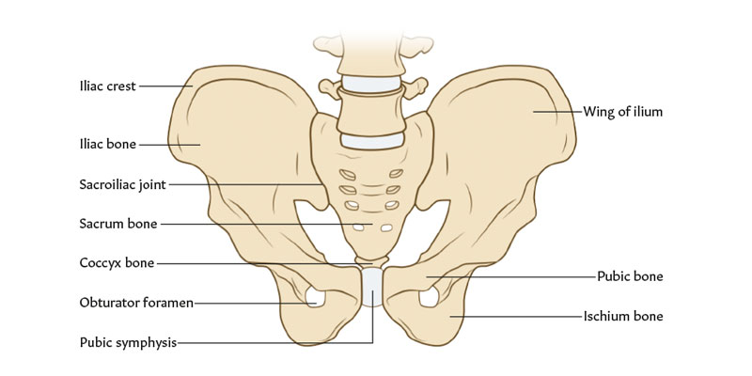

left iliac bone fracture
Spinal canal S2-S3 injury
Sacrum fracture

Slide 7
Surgical interventions
24.12.2022 - Drainage of the left pleural cavity using Bülau technique, laparotomy, revision of the abdominal cavity, retroperitoneal space, ligation of the left internal iliac vein, tamponade of the pelvic cavity and retroperitoneal space, sanitation and drainage of the abdominal cavity, damage control! 24-48 hours, debridement of gluteal wounds, debridement of neck wounds, and drainage of both pleural cavities using Bülau technique.
24.12.2022 - Re-laparotomy, hemostasis, ligation of the left common iliac vein, re-tamponade of the pelvic cavity. Damage control! 24-48 hours;

Slide 8
25.12.2023 - Re-drainage of the left pleural cavity using Bülau technique;
27.12.2022 - Re-laparotomy, removal of hemostatic tampons, re-drainage of the abdominal cavity;
12.01.2023 - Re-laparotomy, removal of the presacral hematoma, sanitation, and drainage of the pelvic cavity; 15.02.2023 - Laminectomy and decompression at the S2-S3 level on both sides.

Slide 9
Operation recomendation
Repair of a plastic bone defect of the pelvic bones combined with the installation of an electronic neurostimulator on the sacral nerve plexus
Goal:
To relieve the pain
To improve the function of the pelvic organs (incontinence) and pelvic muscles;
To improve the genitourinary system and erectile function.

